Slide 1
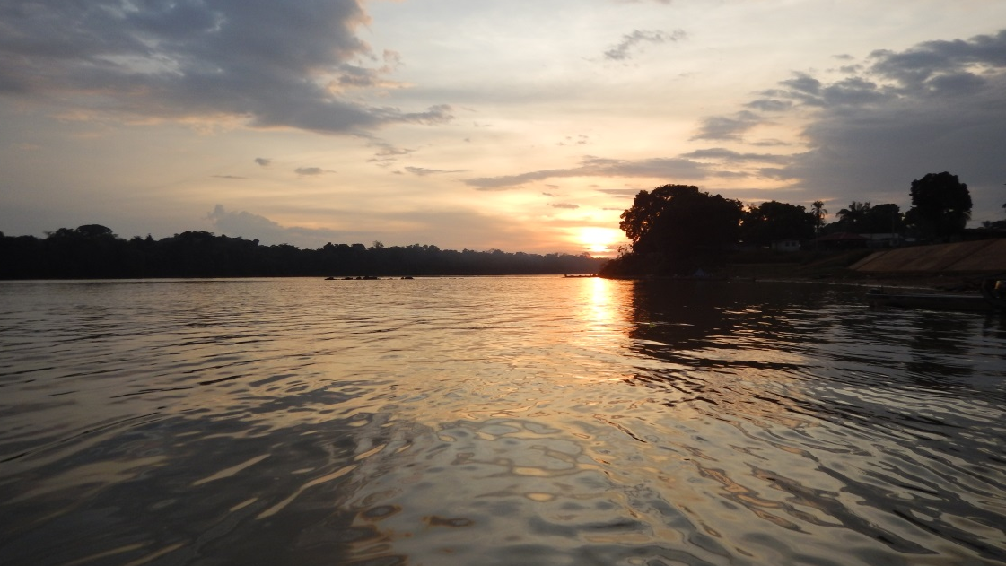
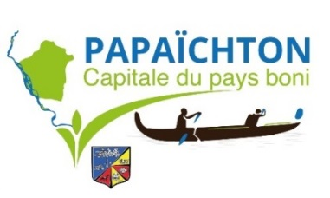
Drinking water resources investigation in Papaïchton Village (French Guiana)
N. Brisset, F. Mathieu, J.M. Gandolfi, B. Dewandel, P. Bourbon, G. Aertgeerts, B. Joseph
27th September 2019
N. Brisset

Slide 2
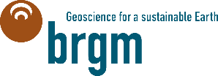
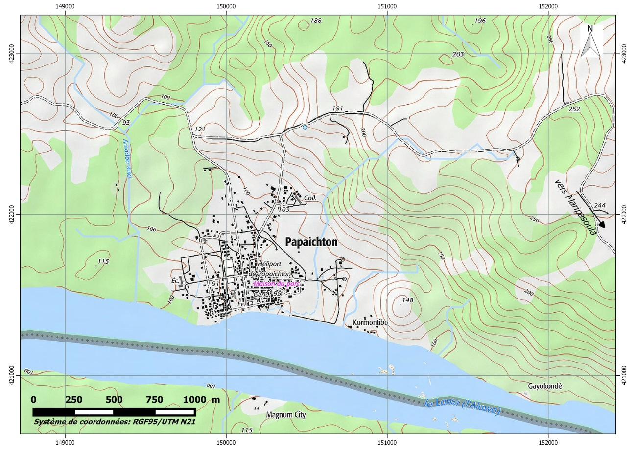
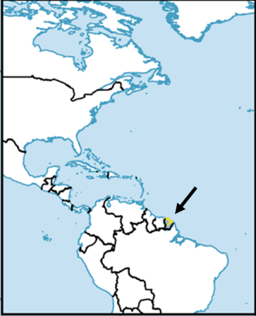
Location
Village center located on the bank of the Maroni River in French Guiana
Border with Suriname
No connexion roads with the main cities of the coastal strip
F2
F1
Maroni
Sting, GFDL & CC-BY-SA
IGN data

Slide 3
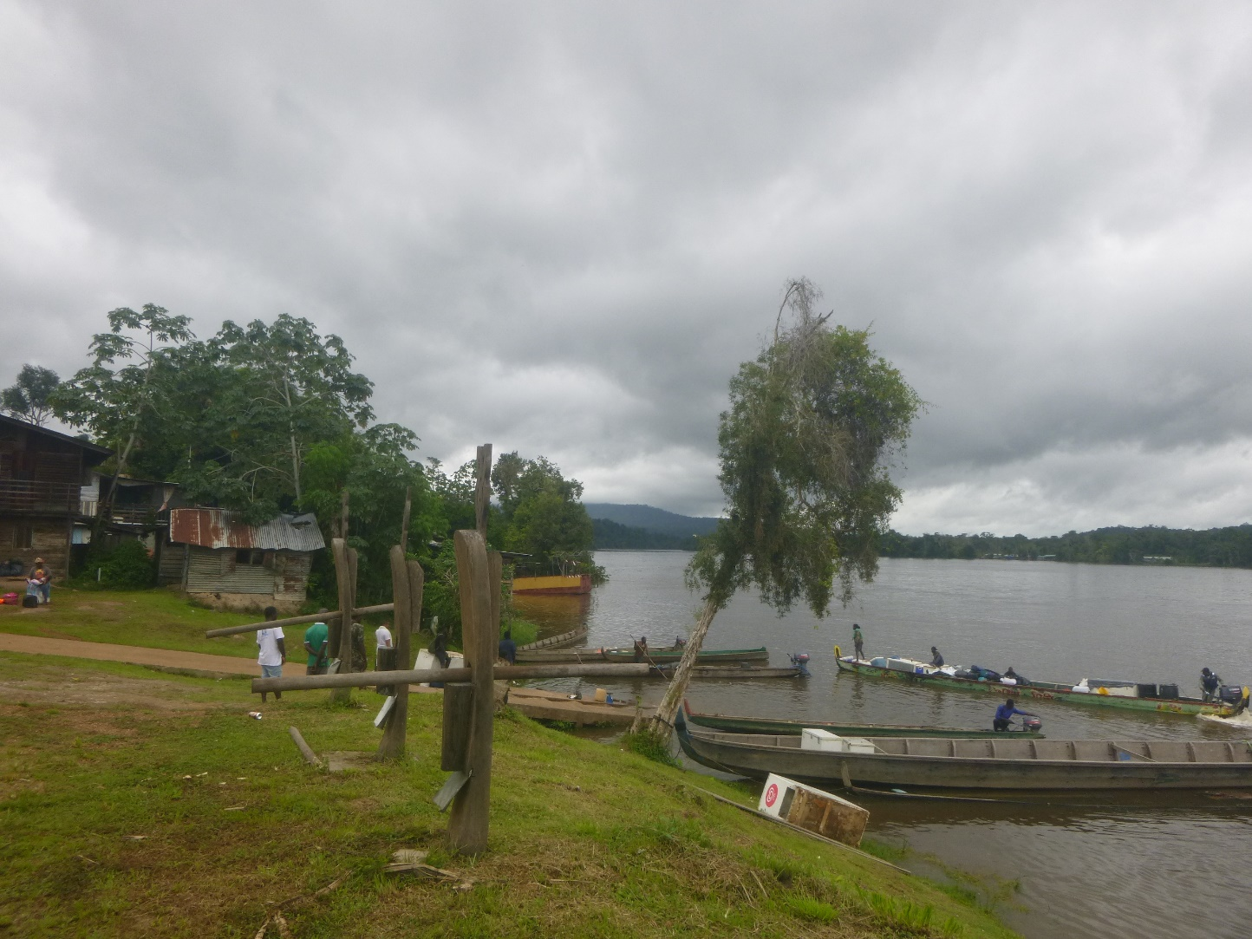
Socio-economic context
Population around 3500 inhabitants with demographic growth > 6 % per year
Local hospital, 2 primary schools and 1 secondary school
Drinking water demand > 200 m³/day (actual production !)
Water distribution cuts in the nights during the dry season…
Potabilisation of the Maroni River requires heavy and energy-intensive treatment processes due to very high turbidity (natural clay particles + mining impact)
New underground water resources needed to obtain more than 400 m³/day
N. Brisset

Slide 4
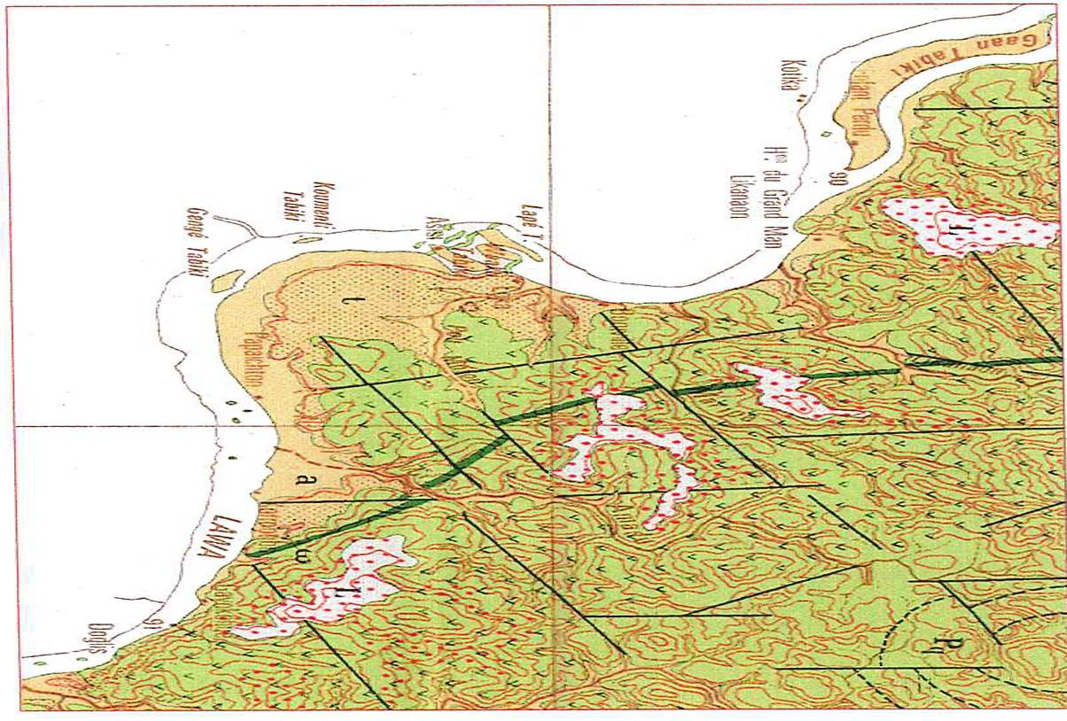
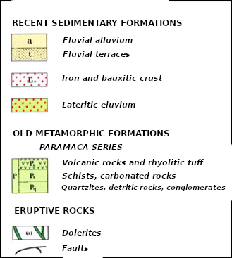
Geological context
Area mainly composed of old metavolcanic rocks and rhyolitic tuff (≈ 2 Gy) intruded by more recent dolerite dyke and quartz veins and affected by tectonic faults
Very strong rock alteration giving sandy-clay alterites on several decameters with iron and bauxitic crust on the top
Alluvial deposits (from 2 to 5 meters) on the Maroni banks
Studied area
Adapted from P.Bourbon, 2016
Choubert, 1961
Maroni

Slide 5
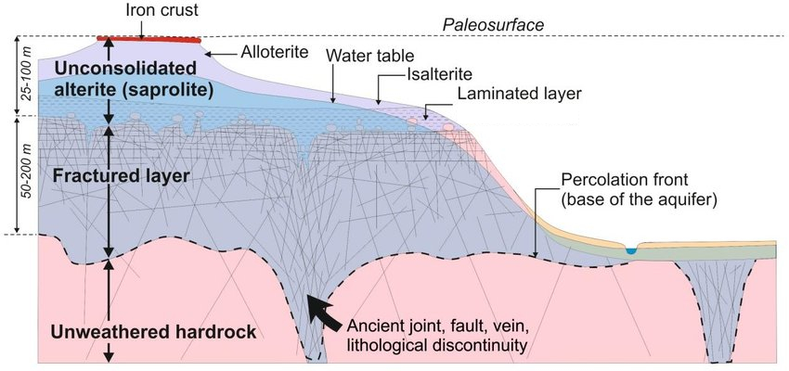
Hydrogeological context
Alluvial aquifer on the Maroni banks : thin thickness and very vulnerable on Papaïchton area. Production from 1 to 2 m³/h
Hardrock aquifer
Fractured layer : fracture network, with draining structure close to the faults and dykes, well protected by the lateritic clay. Production classically between 2 and 6 m³/h in French Guiana
Alterite: in the sandier parts. Production from 0,8 to 2 m³/h
Adapted from R. Wyns, 2004

Slide 6
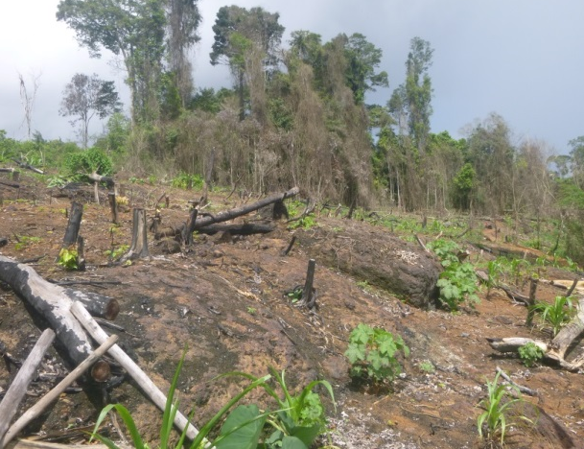
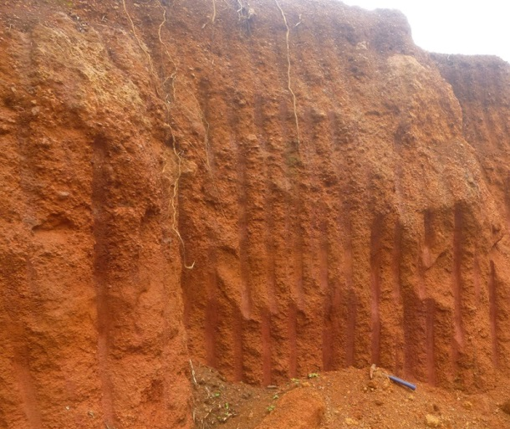
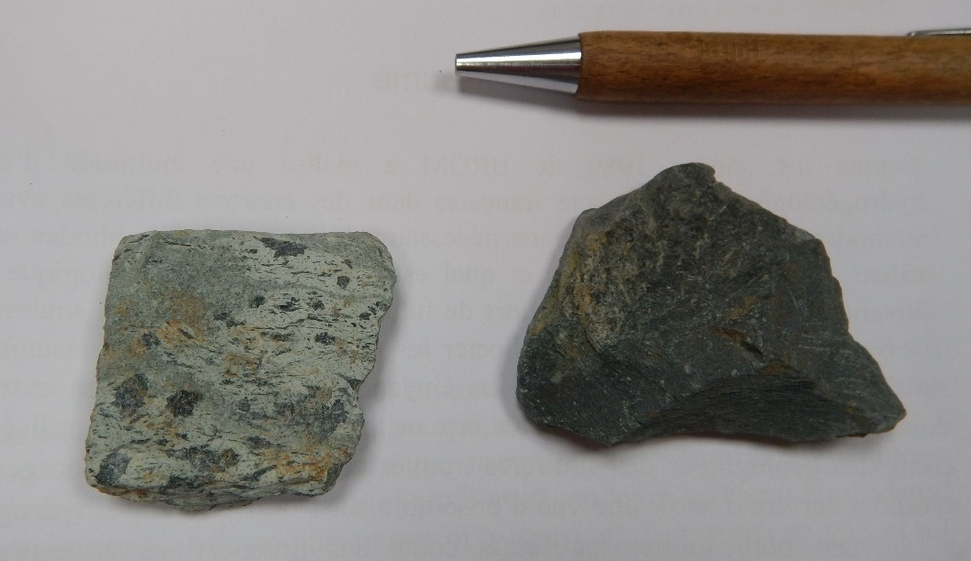
On field observations
Field investigations were conducted to clarify the geological map, to characterize the geomorphology of the site and to understand the springs dynamic
Old spring water catchment in Papaïchton forest
Iron crust dismantled on the slopes
N. Brisset
N. Brisset
Sandy-clay alterites
Metavolcanic rocks with two different lithologies
N. Brisset
N. Brisset

Slide 7
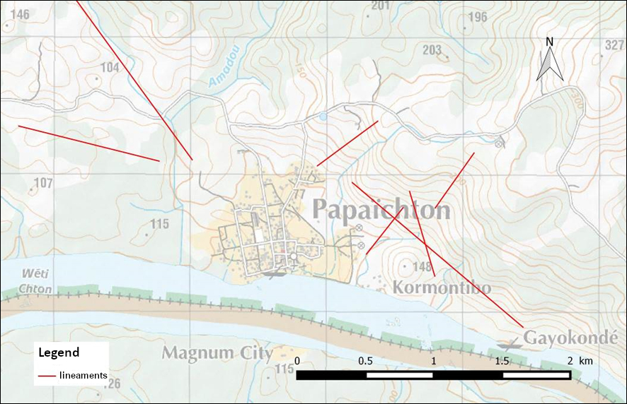
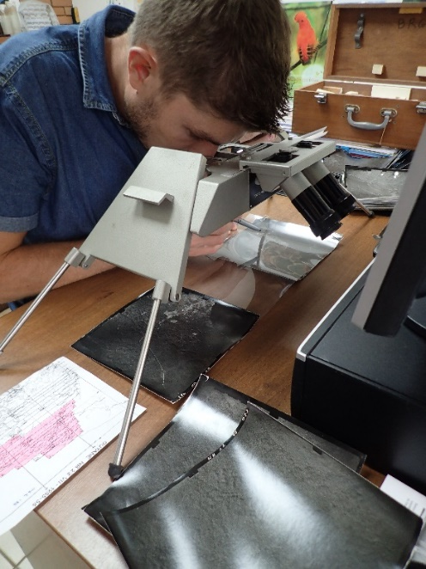
Lineaments research
Vegetation lineaments study by stereoscopy, based on old and recent aerial photographs
The lines highlighted can reflect corridor faults
epod.usra.edu
F. Longueville

Slide 8
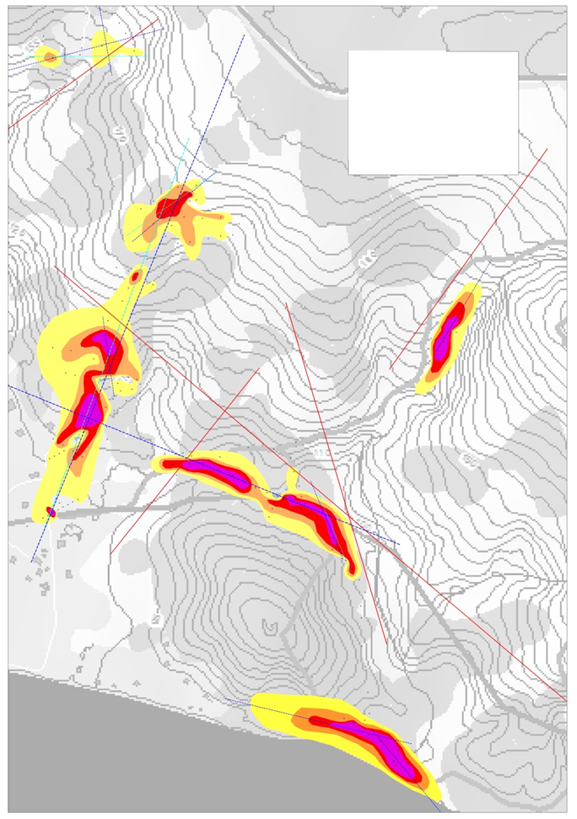
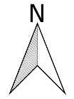
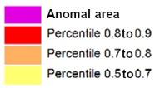
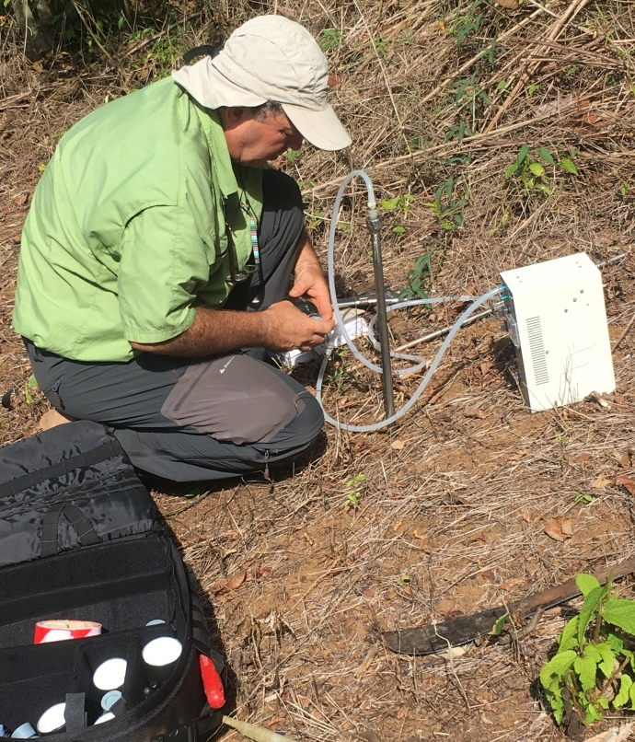
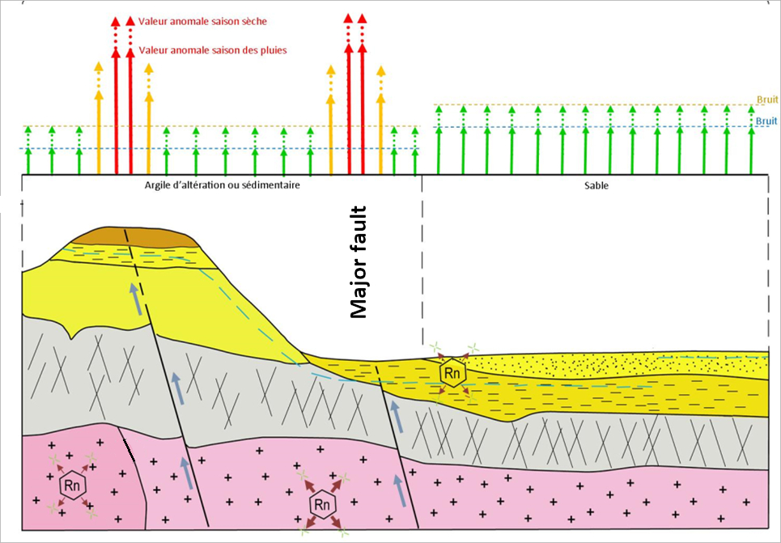
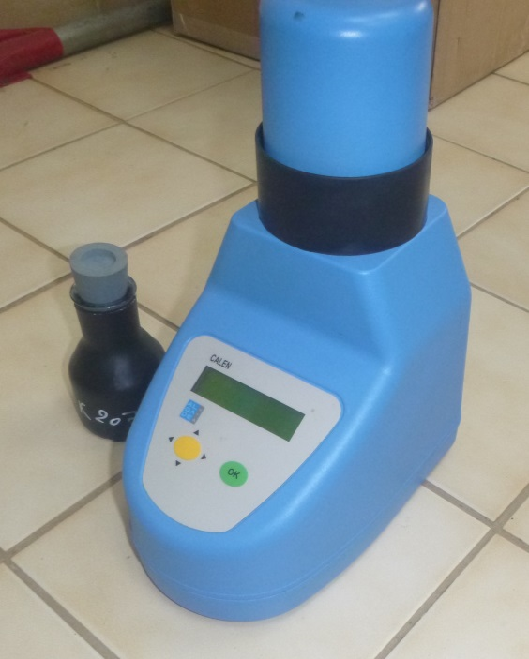
Radon emanometry
202 gas samples from ground subsurface
Zones with Radon anomalies can indicate draining structures and precise the location of the interesting areas
N. Brisset
N. Brisset
J.M. Gandolfi, 2016

Slide 9
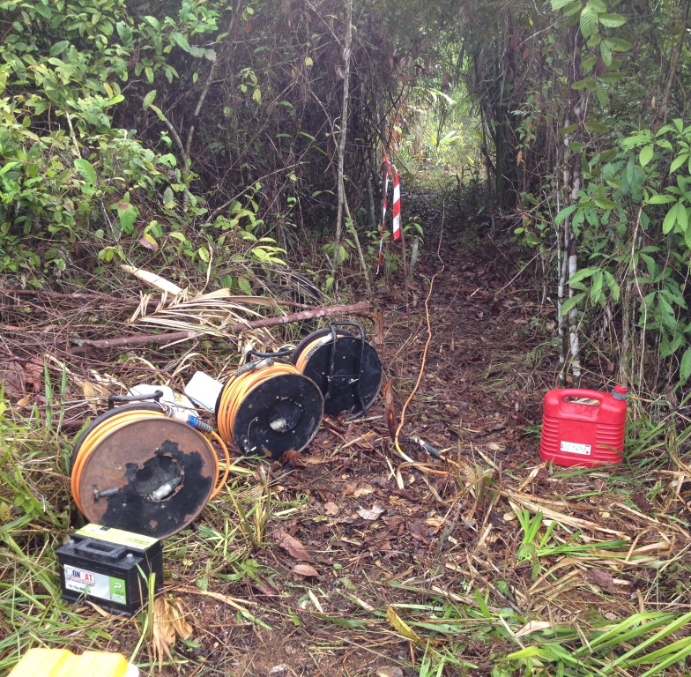
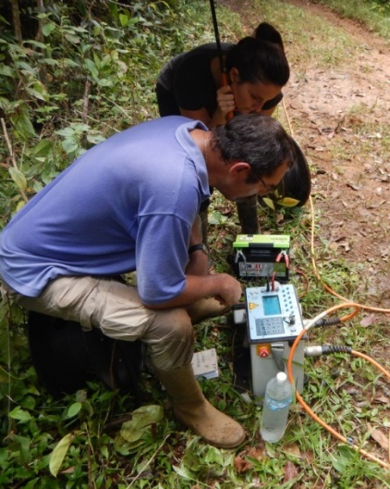
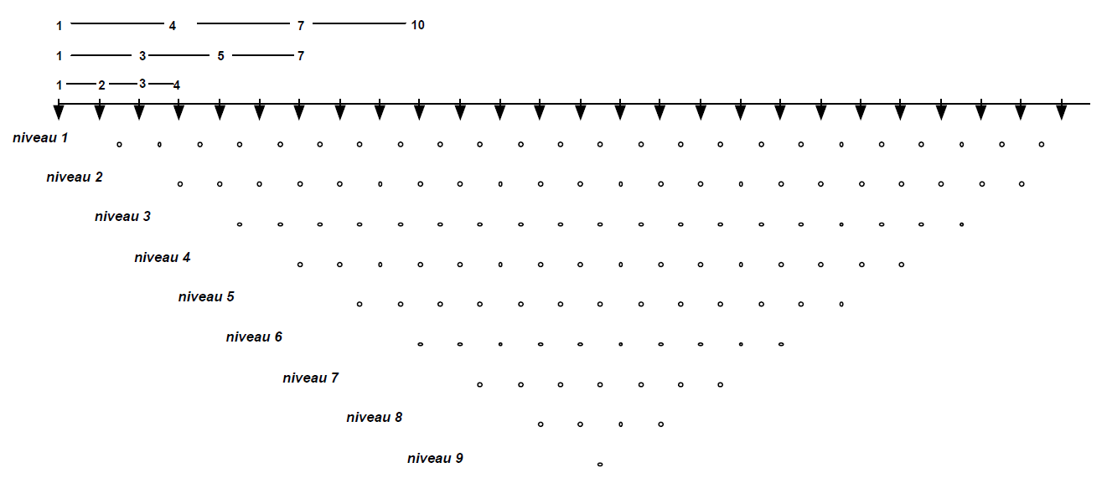
Electrical resistivity tomography
8 tomographies in 2D realized on 4345 linear meters
Signal calibration on the existing wells
Revelation of underground structures and hydrogeological targets → future drilling wells positioning
N. Brisset
D. Chapelier, 2000
F. Mathieu, 2016
N. Brisset
D. Chapelier, 2000
F. Mathieu, 2016

Slide 11
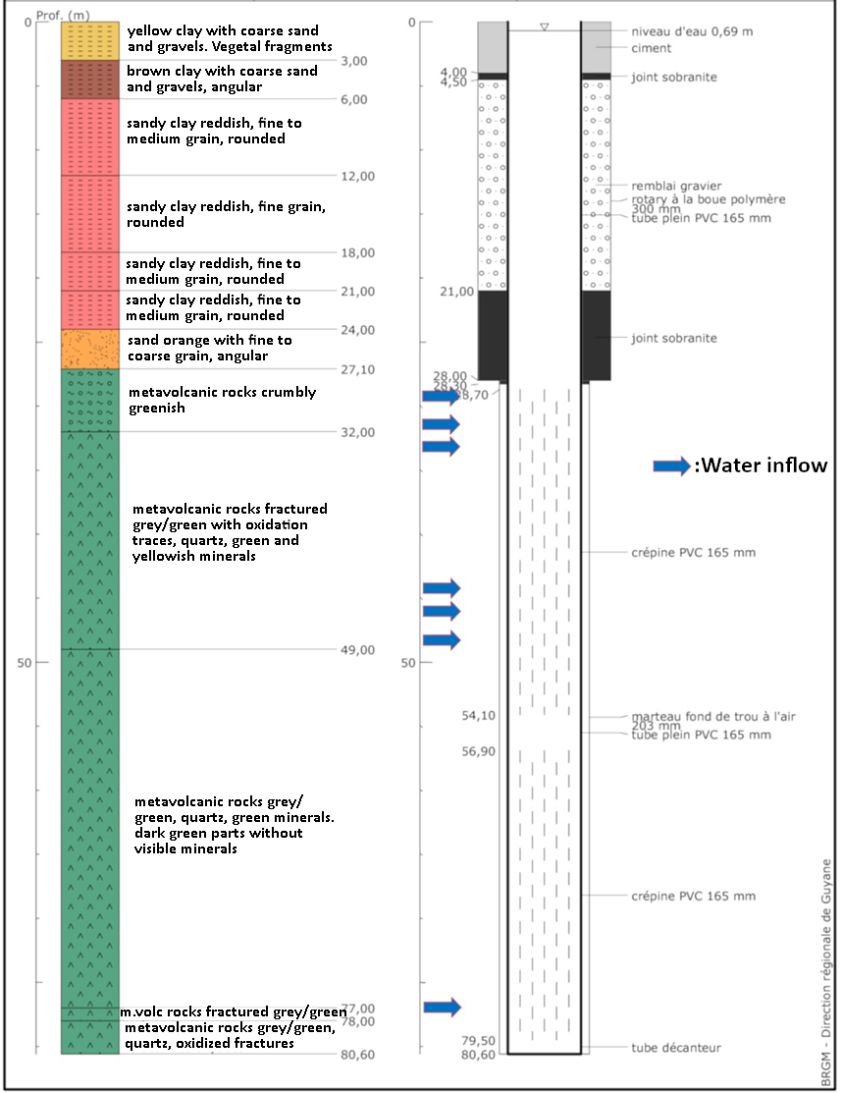
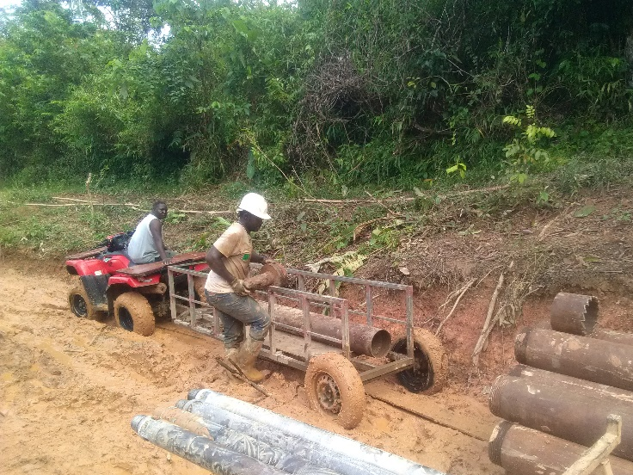
Drilling operations
Drilling equipment transport by pirogue on the Maroni river during the rain season
4 small-diameter exploration drill holes realized on the best hydrogeological targets to evaluate the potential at lower cost
2 water wells designed for the exploitation drilled near the two most productive boreholes
Pumping tests during the dry season
N. Brisset
N. Brisset
N. Brisset

Slide 12
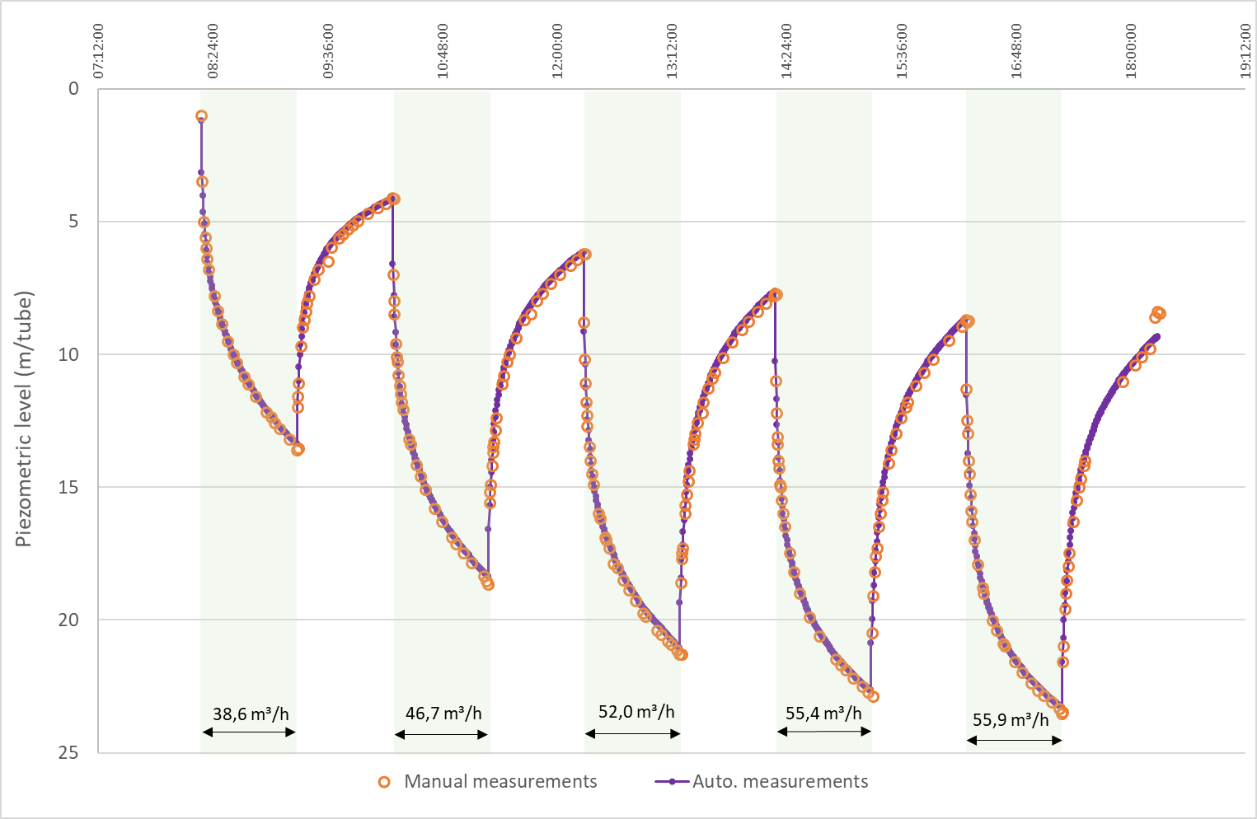
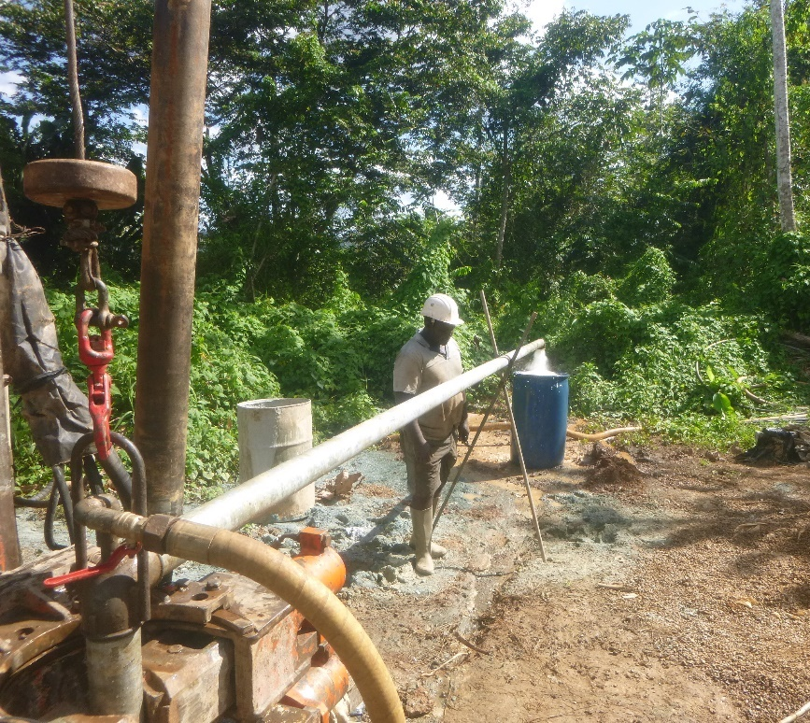
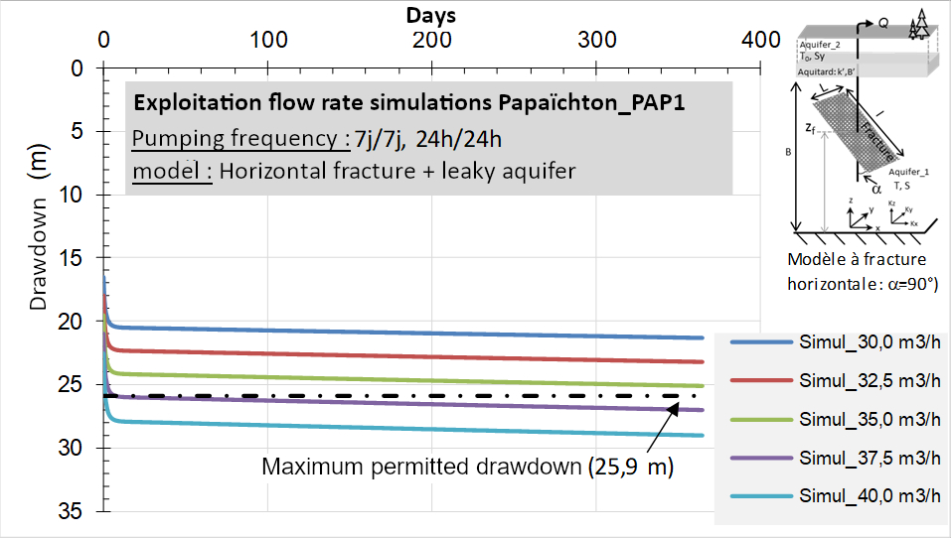
Air lift and pumping tests
Double-column air lift to avoid iron precipitations in the capting chamber due to the oxygenation
Step-tests to determine the critical flow rate and pressure losses
Long-term pumping test (72 h), interpretation with derived method, and simulation with different flow rates to define the exploitation one
N. Brisset, 2019
N. Brisset
B. Dewandel, 2018

Slide 13
Conclusion
With security margin, the two operational boreholes can produce respectively 30 m³/h (actual record in hardrock aquifers for French Guiana) and 5 m³/h
Objectives of 12 m³/h largely exceeded
Demonstration of the importance of groundwater resources in the drinking water supply of isolated sites in French Guiana in order to meet the demographic and development challenges of the territory
This work shows how a combination of prospection methods enables to find interesting hydrogeological targets and productive wells in hard rock aquifers in Amazonian context
N. Brisset

Slide 14
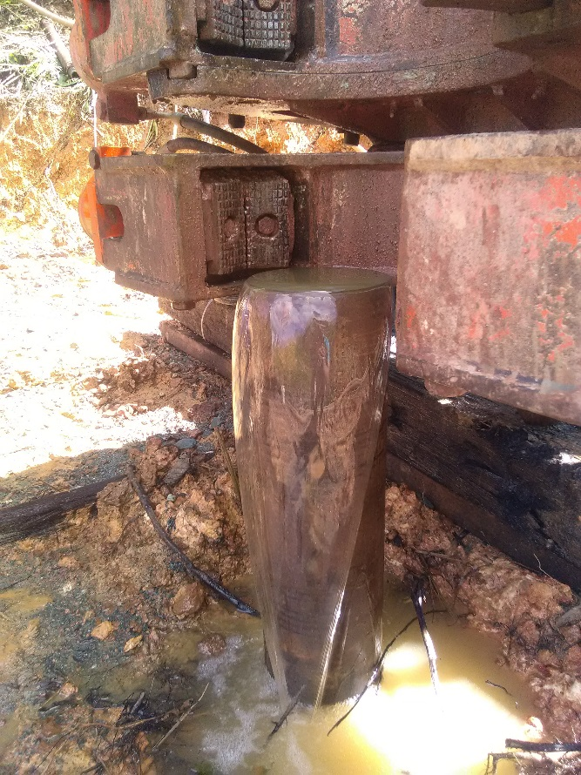
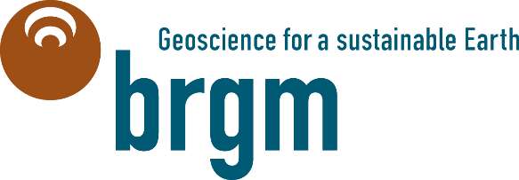
Thank you for your attention !
M. Lhotelin
Artesianism on the PAP1 water well

