Slide 1
GeoScience DWG Welcome
104th OGC Technical Committee – GeoScience DWG session
Southampton, United Kingdom
Mickaël BEAUFILS & Carina KEMP
14 September 2017

Slide 2
Agenda
8h00 – 09h45
Administrative stuff
Set up of a mail list
Wiki page
Election of co-chairs
Presentations and discussion about Borehole description
8h45: Updates on boreholes in EPOS: architecture, BoreholeView (Sylvain GRELLET - BRGM) x2
8h55: Updates on boreholes in EPOS: BoreholeUML model (Henning LORENZ - Uppsala University)
9h00: GeoSciML & GWML for boreholes (Eric BOISVERT - Natural Resources Canada) x2
9h10: WitsML (Jean-François RAINAUD - Energistics)
9h15: Discussion

Slide 3
Agenda
10h15 – 12h00
Presentations and discussion about 3D geomodelling / urban geology / geotechnics / BIM
10h20: Updates on models exchanges in EPOS (Sylvain GRELLET - BRGM)
10h25: ResqML (Jean-François RAINAUD - Energistics)
10h30: 3D geomodel metadata description (Gerold DIEPOLDER - Bavarian Environment Agency)
10h35: i3DGS (Laurent AILLERES - Monash University)
10h40: Geo3DML and CGS experience on urban geology (Honggang QU & Zhang MINGHUA - China Geological Survey) x2
10h50: Standardizing access to geological models and geotechnical information: the SCUDDD and MINND projects (Mickael BEAUFILS - BRGM) x2
11h00: Discussion and wrap-up of session

Slide 4
Administrative information
Mailing list
Will be set up soon!
Who are the first members?
By default, all people invited to this meeting are automatically included into the mailing list (with of course possibility to resign if requested)
Wikipage : Home of GeoScience DWG !
http://external.opengeospatial.org/twiki_public/GeoScienceDWG/WebHome
Public site (not restricted to OGC people)
What can you put here?
Resources from GeoScienceDWG TC meetings (e.g presentations)
Links to interesting project / websites to highlight

Slide 5
Election of co-chairs
According to the charter:
“The Geoscience DWG will have up to three co-chairs, who will coordinate the agenda for OGC meetings”
Candidature of Mickaël BEAUFILS (BRGM)
Candidature of Carina KEMP (GeoScience Australia)

Slide 6
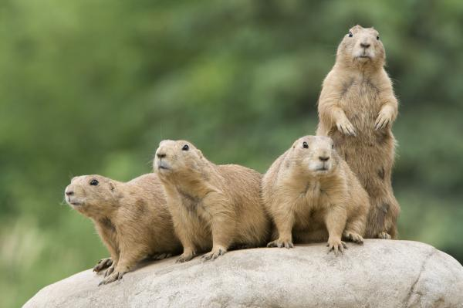
The co-chairs viewpoint
Co-chair

Slide 7
GeoScienceDWG domain of activities: A mix of different disciplines around geology
from Delft TC presentation of GeoScienceDWG
Volcanology
Mineral
resources
Seismology
Soil
Geology
Mining
Oil & gas
Geophysics
HydroGeology
Underground
constructions

Slide 8
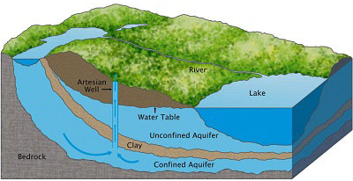
Understanding the subsurface
(from Beaufils & Grellet, INSPIRE 2017)
Gathering evidence
Real
world
Modeled
world
Field observations
Borehole logs
GeoRessource
(water, ore,… )
Geophysics Measurements
…
Human actions
Observation Campaign
Geologic Units
Aquifers
Interpretation
Boreholes
Geologic Structures
Hazard areas
Models
Env. Monitoring Facilities
Geomorphologic Features
…
…
?
Predictions
Spatial representations
(virtual borehole logs, maps, …)
Expected evolution (extrapolation)
Legend:
Features
Observations

Slide 9
Enhancing GeoScience data interoperability
From a user point of view
Can I discover existing data?
Can I daily work with that system?
Can I understand data?
Can I get those data?
1
2
3
4
DATA

Slide 10
Enhancing GeoScience data interoperability
Responses to the needs
Can I discover existing data?
Can I daily work with that system?
Can I understand data?
Can I get those data?
1
2
3
4
DATA
Tools (interfaces, client, …)
Semantics & Linked Data
Standardized exchange protocols
Metadata & catalogs

Slide 11
Key goals
from Delft TC presentation of GeoScienceDWG
Foster technical solutions which support interoperable concepts, data definitions, formats and services for publishing, search, and exchange of geoscientific information.
Ensure thematic/semantic coherence within the Geoscience domains and the Geoscience related ones: Geology, Hydrogeology, Mineral Resources, Surface Hydrology, Soil …
Define proper interfaces with City and Infrastructure related domain
Support proper exchange with Risk monitoring, prevention and management activities
Focus industry and research organizations (incl. RDA) attention on the value added of interoperable approaches
Identify and work with a select set of partners in this area, and initiate demonstration projects to develop and publicize best practices in this area.
Establish a workable approach to managing standards for geoscience spatial features, their temporal aspects, related metadata, and other business information.

Slide 12
Let’s have geoscience data standardization!

Slide 13
Presentations and discussion about Borehole description
8h45: Updates on boreholes in EPOS: architecture, BoreholeView (Sylvain GRELLET - BRGM) x2
8h55: Updates on boreholes in EPOS: BoreholeUML model (Henning LORENZ - Uppsala University)
9h00: GeoSciML & GWML for boreholes (Eric BOISVERT - Natural Resources Canada) x2
9h10: WitsML (Jean-François RAINAUD - Energistics)
9h15: Discussion

Slide 14
Presentations and discussion about 3D geomodelling / urban geology / geotechnics / BIM
10h20: Updates on models exchanges in EPOS (Sylvain GRELLET - BRGM)
10h25: ResqML (Jean-François RAINAUD - Energistics)
10h30: 3D geomodel metadata description (Gerold DIEPOLDER - Bavarian Environment Agency)
10h35: i3DGS (Laurent AILLERES - Monash University)
10h40: Geo3DML and CGS experience on urban geology (Honggang QU & Zhang MINGHUA - China Geological Survey) x2
10h50: Standardizing access to geological models and geotechnical information: the SCUDDD and MINND projects (Mickael BEAUFILS - BRGM) x2
11h00: Discussion and wrap-up of session

